Slide 1
11.0 Describe Animal Health Needs
11.2 Describe the epidermis system

Slide 2
Objectives
Explain the function/organization of the integumentary system.
Identify four of the six terms associated with the integumentary system.
Name and explain the four different tissues of the skin.

Slide 3
Bell Work
* What are some characteristics of “skin”?

Slide 4
What is the Integumentary System?
Outermost layer of the body
Refers specifically to the skin
Integument – comes directly from the word “Latin”, which means “cover”
The first line of defense to invasive microbes

Slide 5
Integumentary System
Is made up of the body’s largest organ – SKIN!
What is its function/purpose?
Protects the body from infections and injury.
Regulates body temperature
Removes waste from the body
Protects against ultraviolet rays

Slide 6
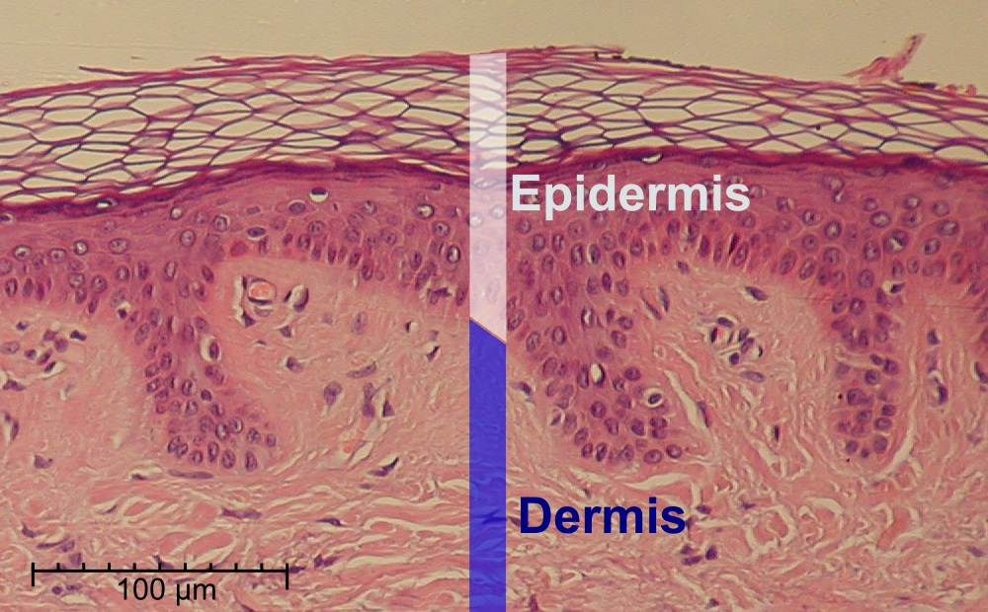
Integumentary System
Epidermis
Outermost layer of skin
Creates keratin – basis of hair, nails, calluses

Slide 7
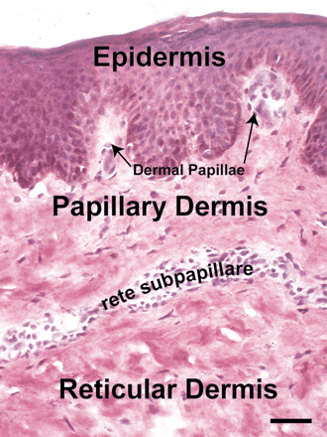
Integumentary System
Dermis
Connective tissue
Provides structural support for the epidermis
Matrix for structures within skin

Slide 8
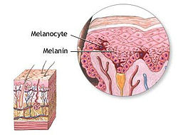
Integumentary System
Pigment
Skin color due to production of melanocyte cells

Slide 9
Integumentary System
Subcutaneous
The area between the skin and tissues.

Slide 10
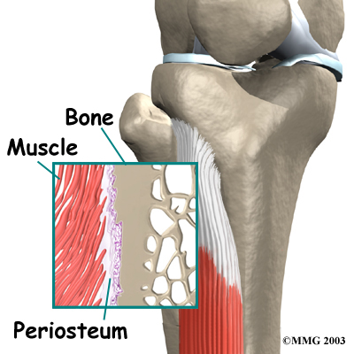
Integumentary System
.
Periosteum
Is a tough membrane that surrounds the bone.

Slide 11
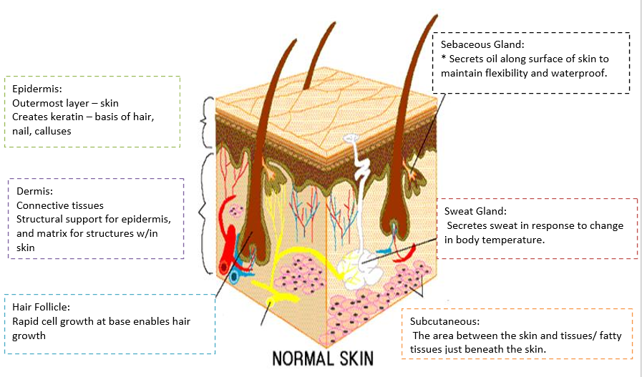

Slide 12
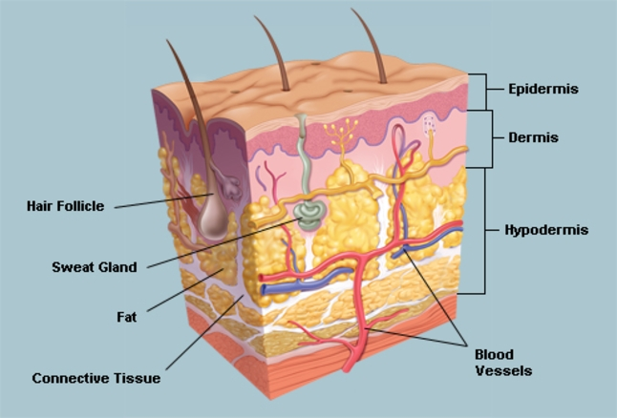

Slide 13
“GO GET IT” Activity…

Slide 14
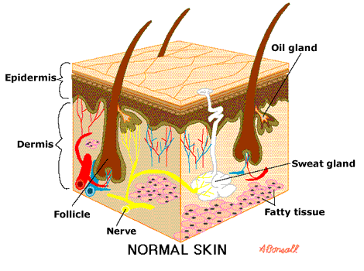
Skin Tissues
.
Sweat Glands
Secrets sweat in response to change in body temperature.

Slide 15
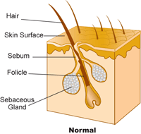
Skin Tissues
.
Sebaceous gland
secrets oil along surface of skin to maintain flexibility and waterproof

Slide 16
Skin Tissues
.
Hair Follicles
Rapid cell growth at base enables hair growth

Slide 17
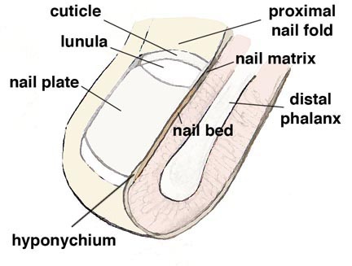
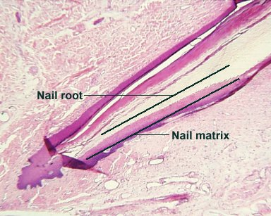
Skin Tissues
Nail Matrix
At tips of fingers and toes
Keratin fills the cells of the nail matrix to produce protective layer.
.

